Slide 1
Lecture 20: Support Vector Machines (SVMs)

Slide 2
Outline
Classifying Linear Separable Data
Classifying Linear Non-Separable Data
Kernel Trick
Text Reading: Ch. 9, p. 337-356

Slide 3
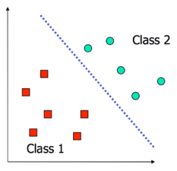
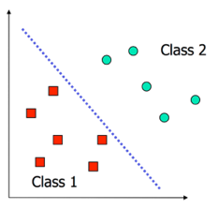
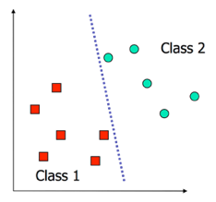
Decision Boundaries Revisited
In logistic regression, we learn a decision boundary that separates the training classes in the feature space.
When the data can be perfectly separated by a linear boundary, we call the data linearly separable.
In this case, multiple decision boundaries can fit the data. How do we choose the best?
Question: What happens to our logistic regression model when training on linearly separable datasets?

Slide 4
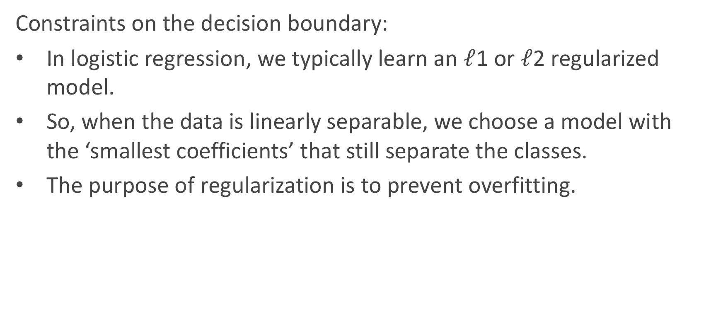
Decision Boundaries Revisited (cont.)
Constraints on the decision boundary:
In logistic regression, we typically learn an $ℓ$1 or $ℓ$2 regularized model.
So, when the data is linearly separable, we choose a model with the ‘smallest coefficients’ that still separate the classes.
The purpose of regularization is to prevent overfitting.

Slide 5
Decision Boundaries Revisited (cont.)
Constraints on the decision boundary:
We can consider alternative constraints that prevent overfitting.
For example, we may prefer a decision boundary that does not ‘favor’ any class (esp. when the classes are roughly equally populous).
Geometrically, this means choosing a boundary that maximizes the distance or margin between the boundary and both classes.

Slide 6
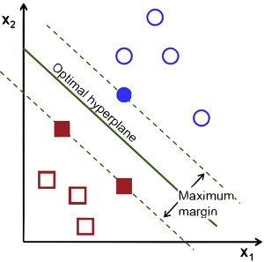
Illustration of an SVM

Slide 7
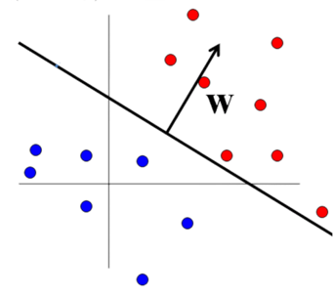
Geometry of Decision Boundaries
Recall that the decision boundary is defined by some equation in terms of the predictors. A linear boundary is defined by:
w⊤x + b = 0 (General equation of a hyperplane)
Recall that the non-constant coefficients, w, represent a normal vector, pointing orthogonally away from the plane

Slide 8
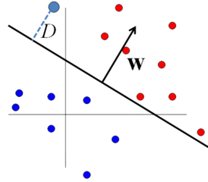
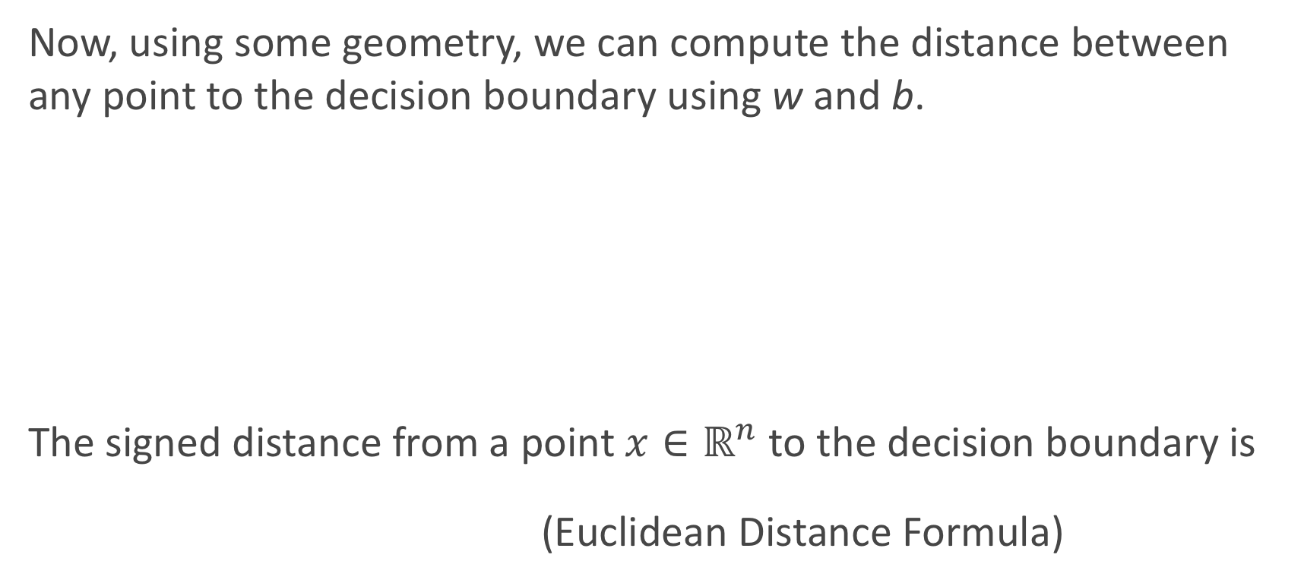
Geometry of Decision Boundaries (cont.)
Now, using some geometry, we can compute the distance between any point to the decision boundary using w and b.
The signed distance from a point $x∈ℝ^{n}$ to the decision boundary is
(Euclidean Distance Formula)

Slide 9
Maximizing Margins
Now we can formulate our goal - find a decision boundary that maximizes the distance to both classes - as an optimization problem:
where M is a real number representing the width of the ‘margin’ and y_{i} = ±1. The inequalities |D(x_{n})| ≥ M are called constraints.
The constrained optimization problem as present here looks tricky. Let’s simplify it with a little geometric intuition.

Slide 10
Maximizing Margins (cont.)
Notice that maximizing the distance of all points to the decision boundary, is exactly the same as maximizing the distance to the closest points.
The points closest to the decision boundary are called support vectors.
For any plane, we can always scale the equation:
w⊤x + b = 0 so that the support vectors lie on the planes:
w⊤x + b = ±1,
depending on their classes.

Slide 11
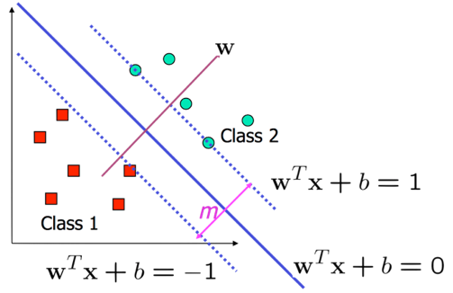
Maximizing Margins Illustration
For points on planes w⊤x + b = ±1, their distance to the decision boundary is ±1/∥w∥.
So we can define the margin of a decision boundary as the distance to its support vectors, m = 2/∥w∥.

Slide 12
Support Vector Classifier: Hard Margin
Finally, we can reformulate our optimization problem - find a decision boundary that maximizes the distance to both classes - as the maximization of the margin, m, while maintaining zero misclassifications,
The classifier learned by solving this problem is called hard margin support vector classification.
Often SVC is presented as a minimization problem:

Slide 13
SVC and Convex Optimization
As a convex optimization problem SVC has been extensively studied and can be solved by a variety of algorithms:
(Stochastic) libLinear Fast convergence, moderate computational cost
(Greedy) libSVM Fast convergence, moderate computational cost
(Stochastic) Stochastic Gradient Descent Slow convergence, low computational cost per iteration
(Greedy) Quasi-Newton Method Very fast convergence, high computational cost

Slide 14
Classifying Linear Non-Separable Data

Slide 15
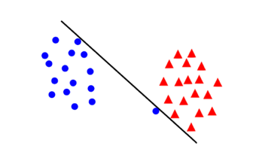
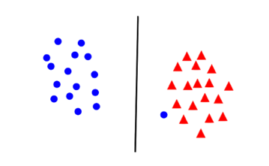
Geometry of Data
Maximizing the margin is a good idea as long as we assume that the underlying classes are linear separable and that the data is noise free.
If data is noisy, we might be sacrificing generalizability in order to minimize classification error with a very narrow margin:
With every decision boundary, there is a trade-off between maximizing margin and minimizing the error.

Slide 16
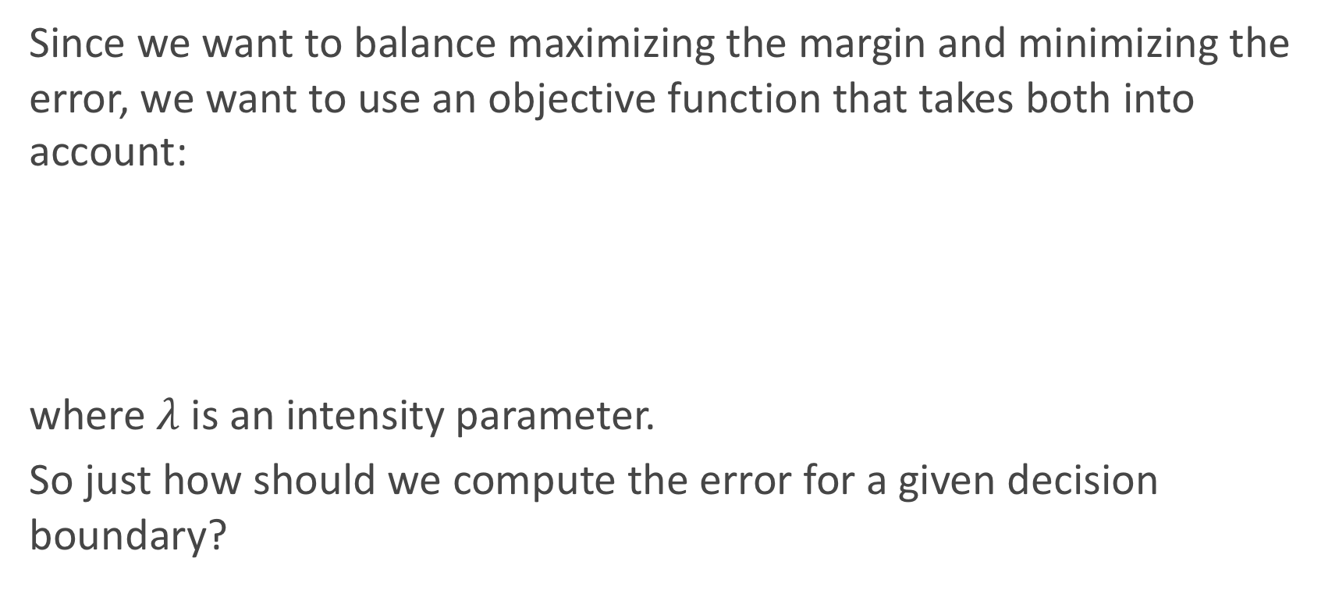
Support Vector Classifier: Soft Margin
Since we want to balance maximizing the margin and minimizing the error, we want to use an objective function that takes both into account:
where $λ$ is an intensity parameter.
So just how should we compute the error for a given decision boundary?

Slide 17
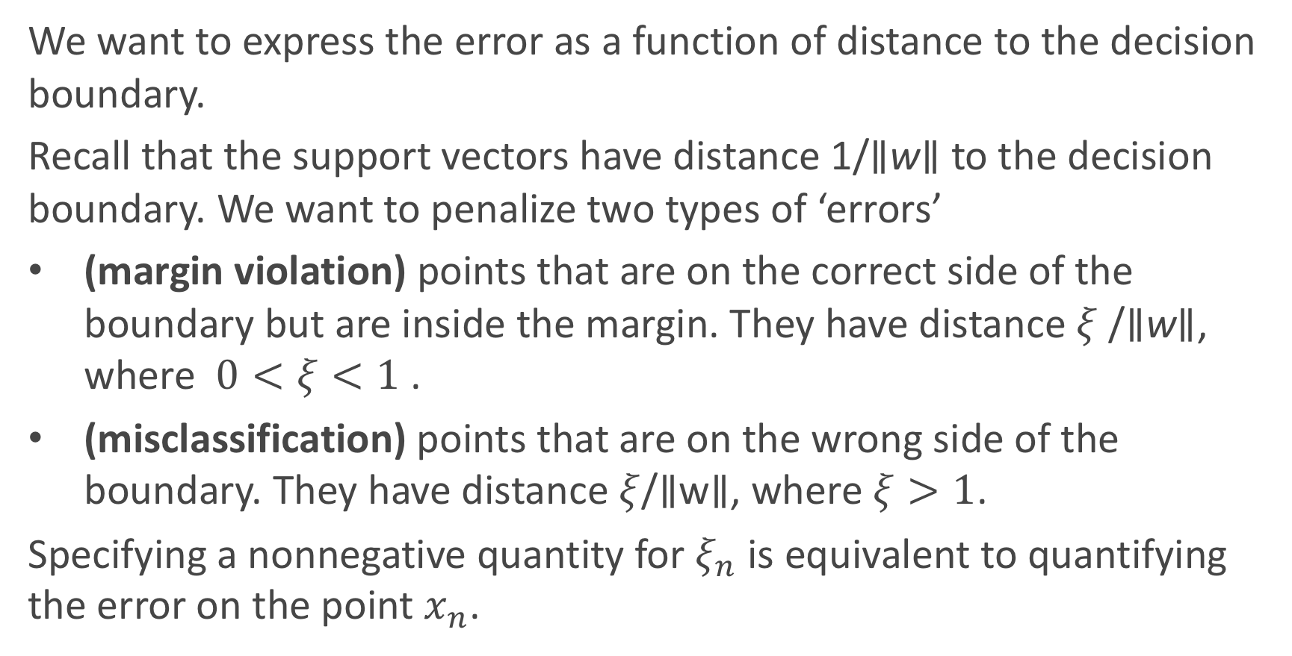
Support Vector Classifier: Soft Margin (cont.)
We want to express the error as a function of distance to the decision boundary.
Recall that the support vectors have distance 1/∥w∥ to the decision boundary. We want to penalize two types of ‘errors’
(margin violation) points that are on the correct side of the boundary but are inside the margin. They have distance $ξ$/∥w∥, where $0<ξ<1$ .
(misclassification) points that are on the wrong side of the boundary. They have distance $ξ$/∥w∥, where $ξ>1$.
Specifying a nonnegative quantity for $ξ_{n}$ is equivalent to quantifying the error on the point $x_{n}$.

Slide 18
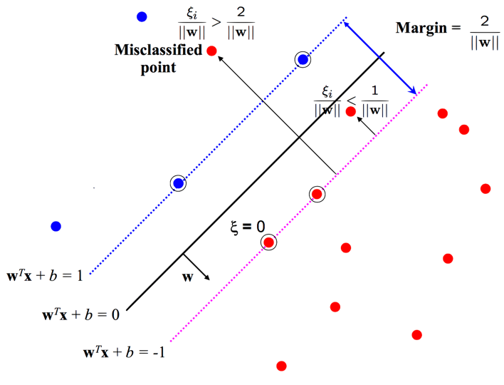
Support Vector Classifier: Soft Margin Illustration

Slide 19
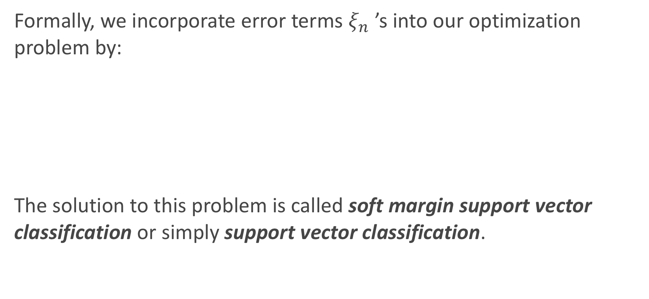
Support Vector Classifier: Soft Margin (cont.)
Formally, we incorporate error terms $ξ_{n}$ ’s into our optimization problem by:
The solution to this problem is called soft margin support vector classification or simply support vector classification.

Slide 20
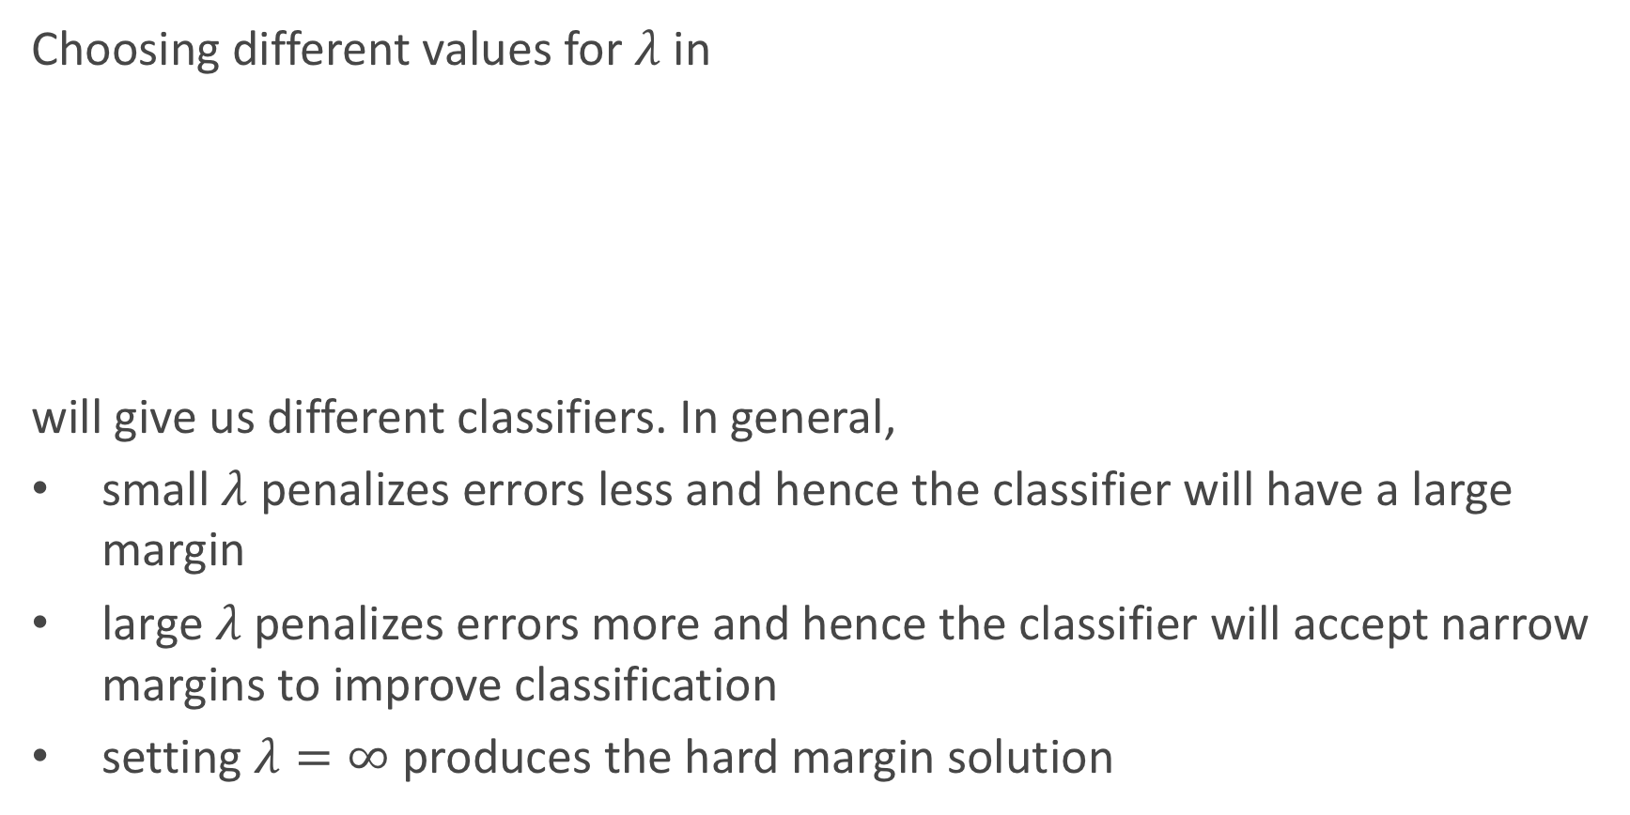
Tuning SVC
Choosing different values for $λ$ in
will give us different classifiers. In general,
small $λ$ penalizes errors less and hence the classifier will have a large margin
large $λ$ penalizes errors more and hence the classifier will accept narrow margins to improve classification
setting $λ=∞$ produces the hard margin solution

Slide 21
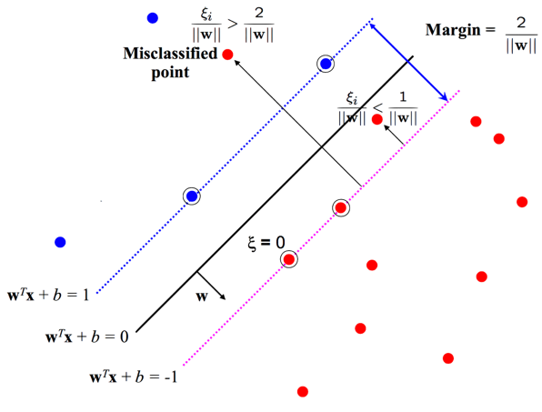

Decision Boundaries and Support Vectors
Recall how the error terms $ξ_{n}$’s were defined: the points where $ξ_{n}$ = 0 are precisely the support vectors

Slide 22
Decision Boundaries and Support Vectors
Thus to re-construct the decision boundary, only the support vectors are needed!

Slide 23

Decision Boundaries and Support Vectors
The decision boundary of an SVC is given by
where ${\hat{α}}_{n}$and the set of support vectors are found by solving the optimization problem.
To classify a test point x_{test}, we predict

Slide 24
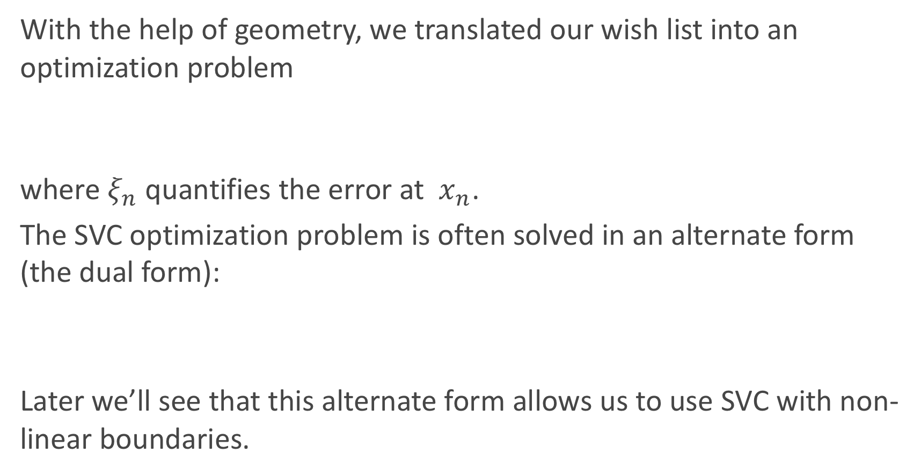
SVC as Optimization
With the help of geometry, we translated our wish list into an optimization problem
where $ξ_{n}$ quantifies the error at $x_{n}$.
The SVC optimization problem is often solved in an alternate form (the dual form):
Later we’ll see that this alternate form allows us to use SVC with non-linear boundaries.

Slide 25
Extension to Non-linear Boundaries

Slide 26
Polynomial Regression: Two Perspectives
Given a training set:
with a single real-valued predictor, we can view fitting a 2nd degree polynomial model:
on the data as the process of finding the best quadratic curve that fits the data. But in practice, we first expand the feature dimension of the training set
and train a linear model on the expanded data

Slide 27
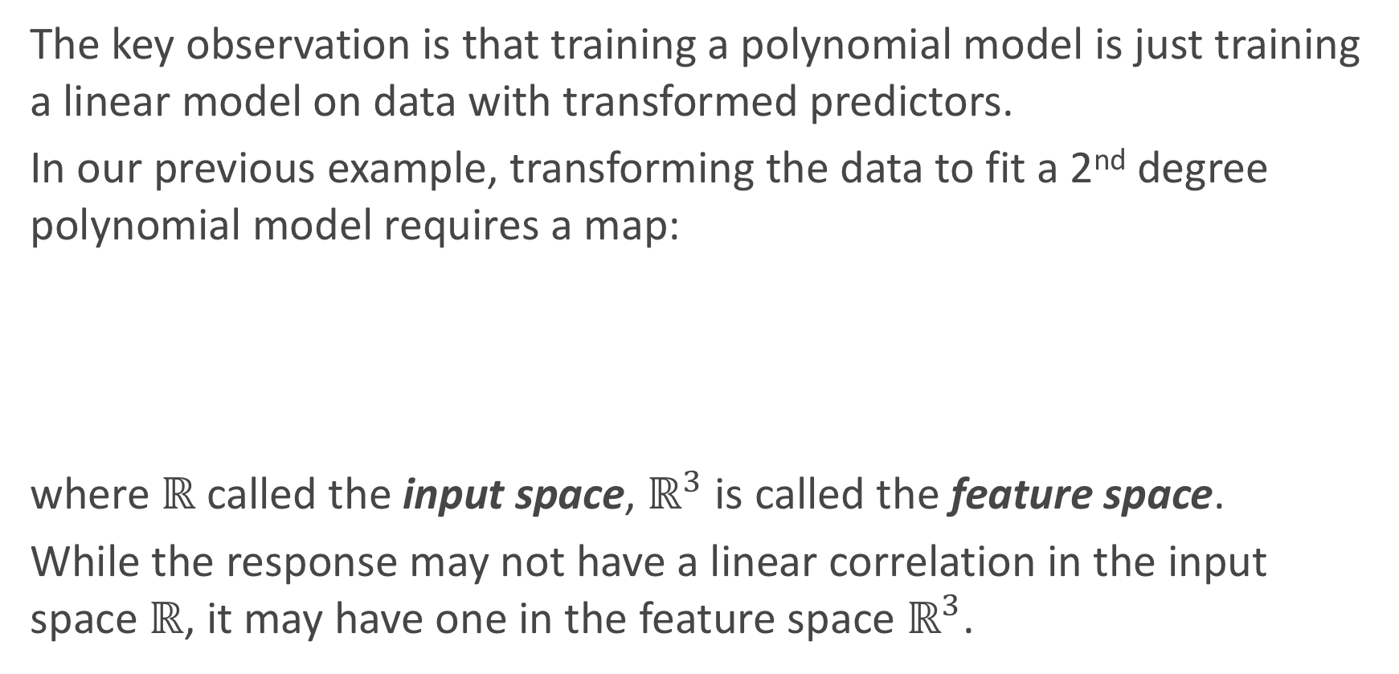
Transforming the Data
The key observation is that training a polynomial model is just training a linear model on data with transformed predictors.
In our previous example, transforming the data to fit a 2nd degree polynomial model requires a map:
where $ℝ$ called the input space, $ℝ^{3}$ is called the feature space.
While the response may not have a linear correlation in the input space $ℝ$, it may have one in the feature space $ℝ^{3}$.

Slide 28
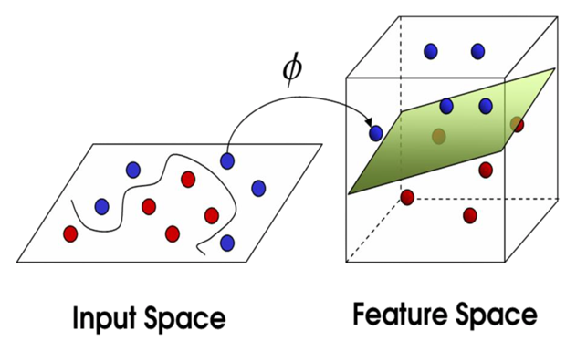
SVC with Non-Linear Decision Boundaries
The same insight applies to classification: while the response may not be linear separable in the input space, it may be in a feature space after a fancy transformation:

Slide 29
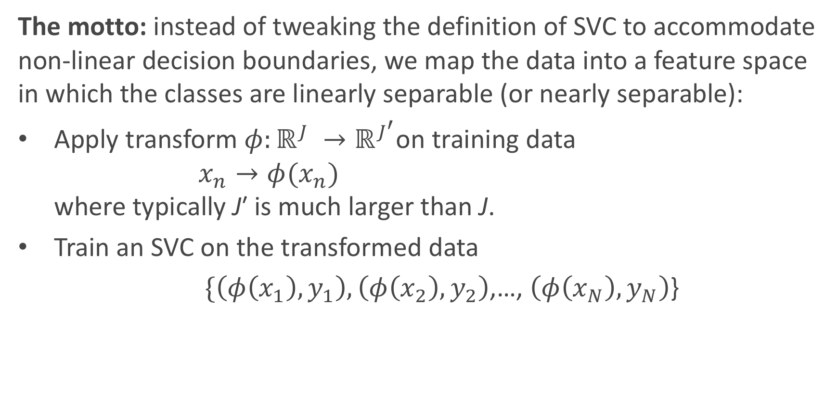
SVC with Non-Linear Decision Boundaries (cont.)
The motto: instead of tweaking the definition of SVC to accommodate non-linear decision boundaries, we map the data into a feature space in which the classes are linearly separable (or nearly separable):
Apply transform $φ:ℝ^{J} →ℝ^{J^{′}}$on training data $x_{n}→φ(x_{n})$ where typically J′ is much larger than J.
Train an SVC on the transformed data
$\{\left(φ\left(x_{1}\right),y_{1}\right),\left(φ\left(x_{2}\right),y_{2}\right)$,…, $\left(φ\left(x_{N}\right),y_{N}\right)$}

Slide 30
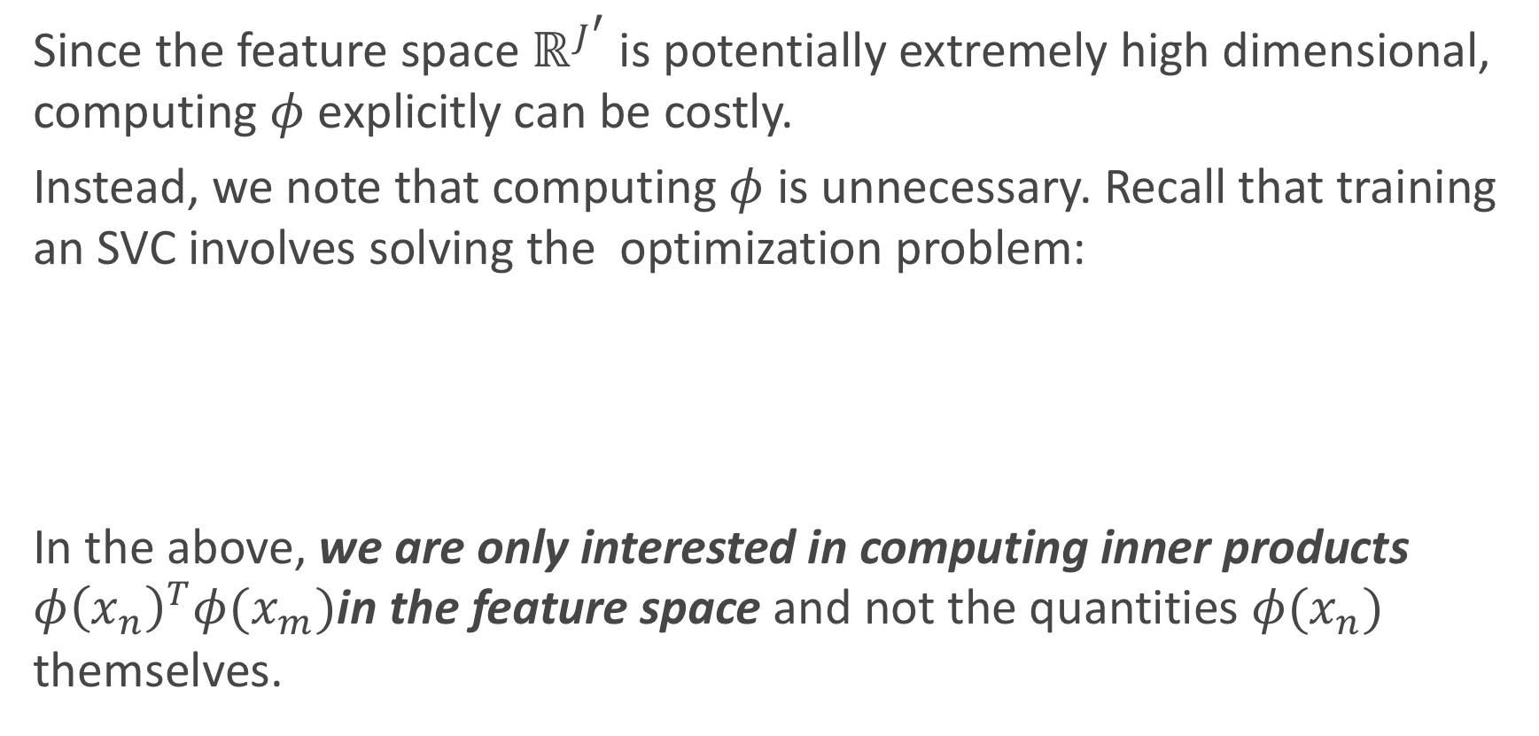
Inner Products
Since the feature space $ℝ^{J^{′}}$is potentially extremely high dimensional, computing $φ$ explicitly can be costly.
Instead, we note that computing $φ$ is unnecessary. Recall that training an SVC involves solving the optimization problem:
In the above, we are only interested in computing inner products $φ{\left(x_{n}\right)}^{T}φ(x_{m})$in the feature space and not the quantities $φ(x_{n})$ themselves.

Slide 31
The Kernel Trick
The inner product between two vectors is a measure of the similarity of the two vectors.

Slide 32
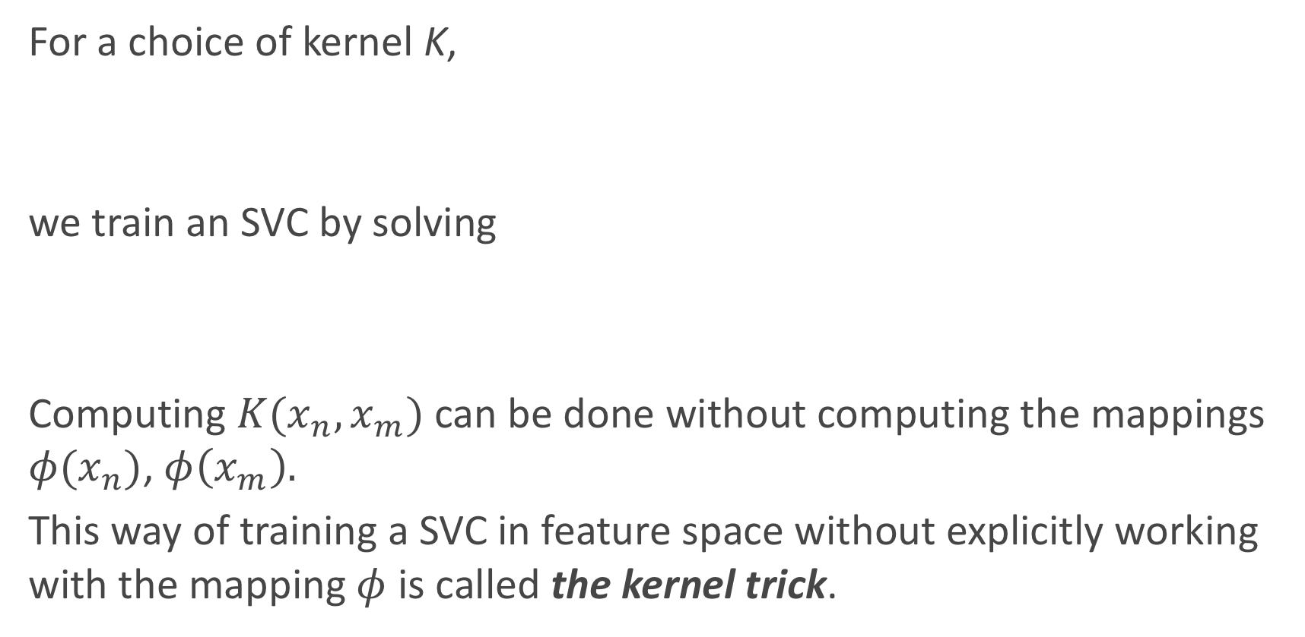
The Kernel Trick (cont.)
For a choice of kernel K,
we train an SVC by solving
Computing $K(x_{n},x_{m})$ can be done without computing the mappings $φ(x_{n})$, $φ\left(x_{m}\right).$
This way of training a SVC in feature space without explicitly working with the mapping $φ$ is called the kernel trick.

Slide 33
Transforming Data: An Example

Slide 34
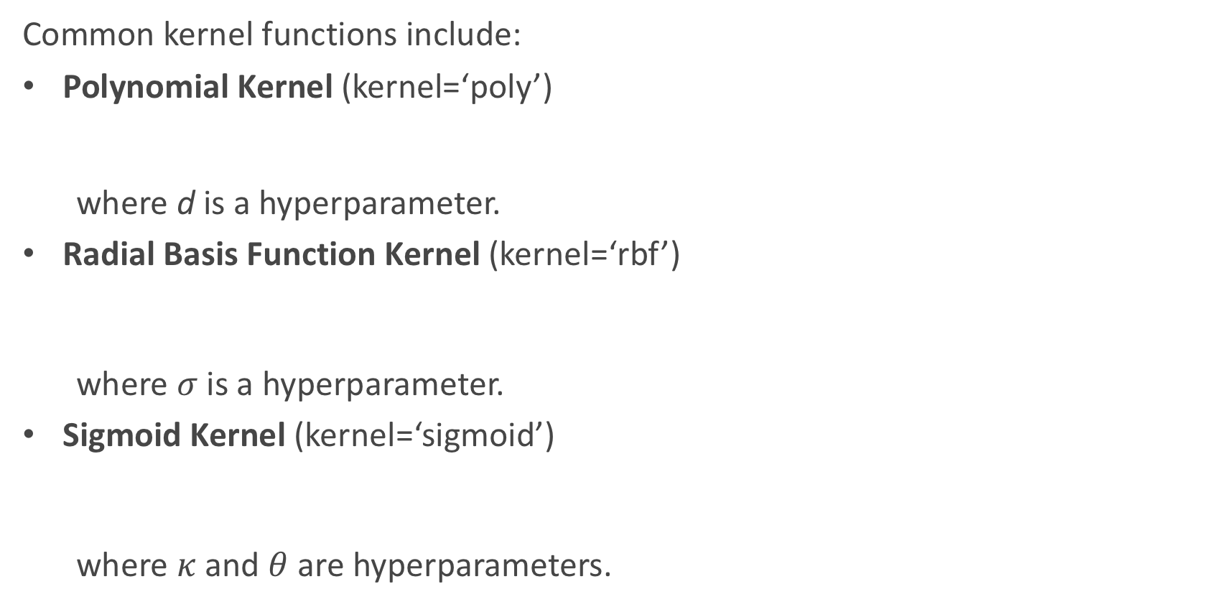
Kernel Functions
Common kernel functions include:
Polynomial Kernel (kernel=‘poly’)
where d is a hyperparameter.
Radial Basis Function Kernel (kernel=‘rbf’)
where $σ$ is a hyperparameter.
Sigmoid Kernel (kernel=‘sigmoid’)
where $κ$ and $θ$ are hyperparameters.

Slide 35
Happy Thanksgiving!

